Slide 1
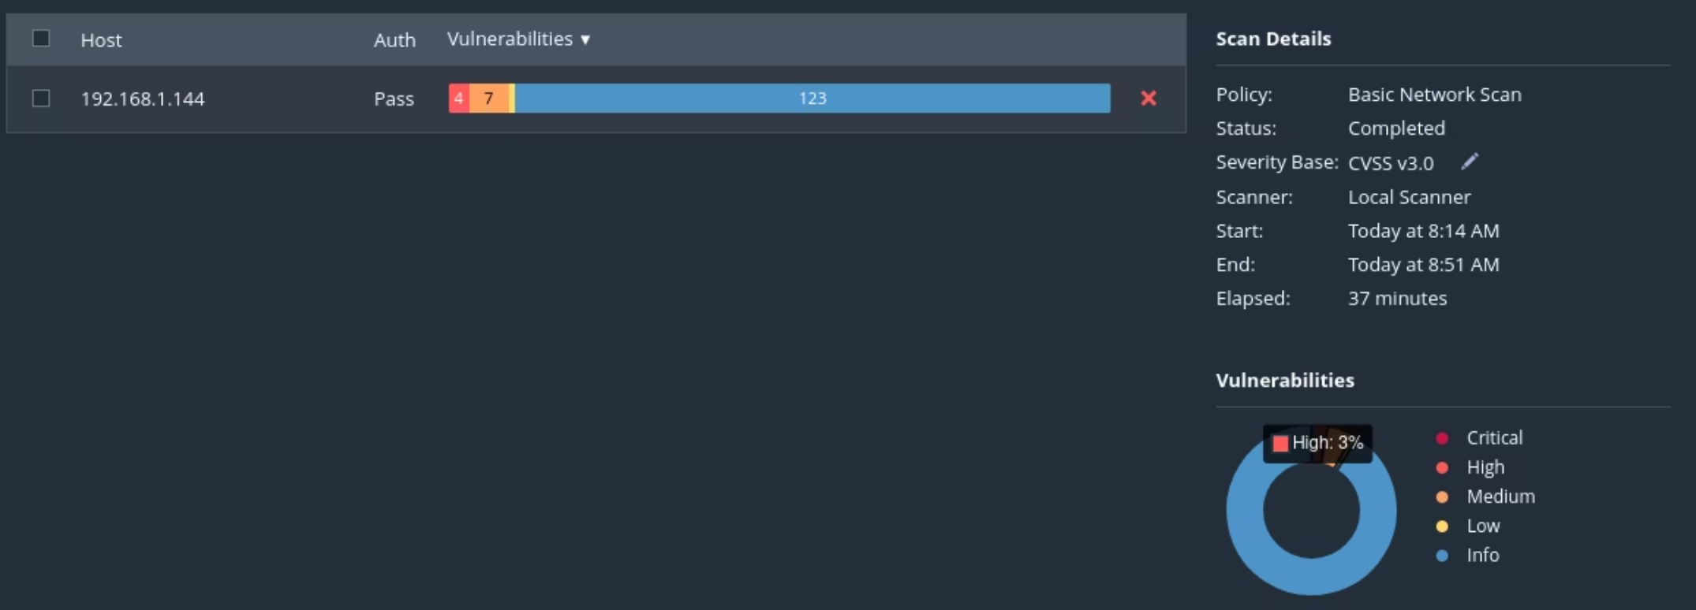
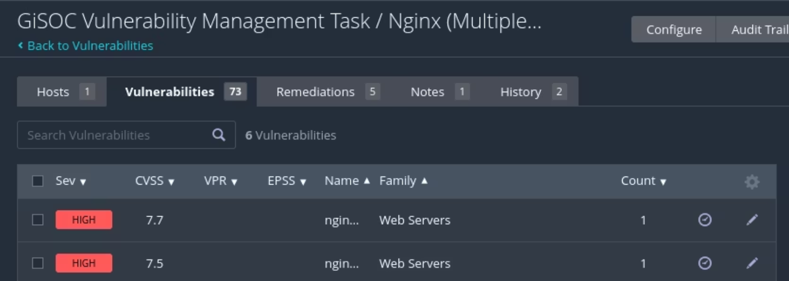
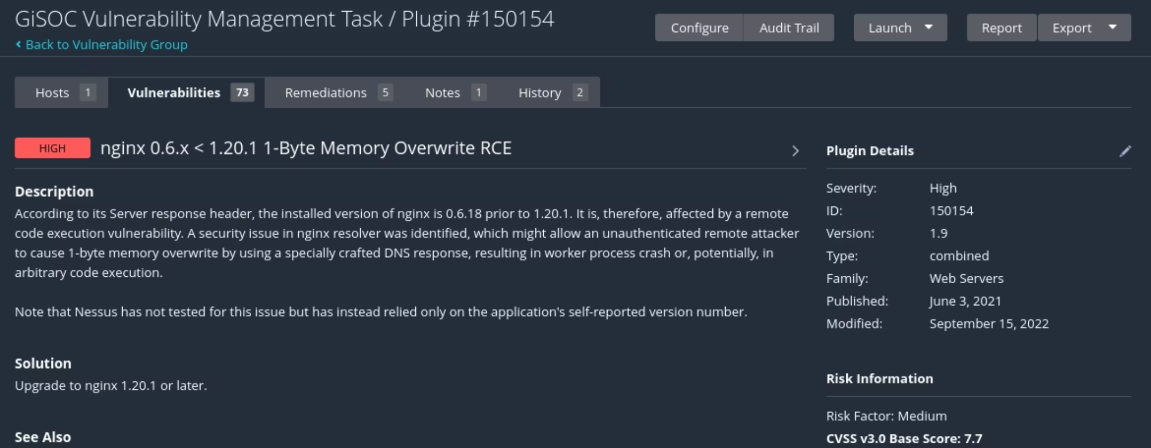
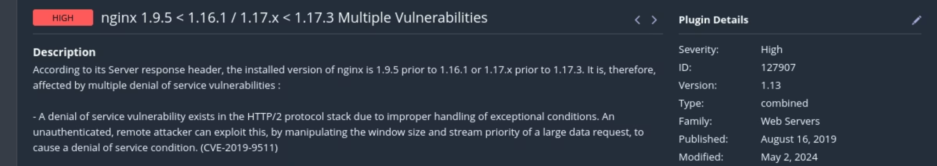
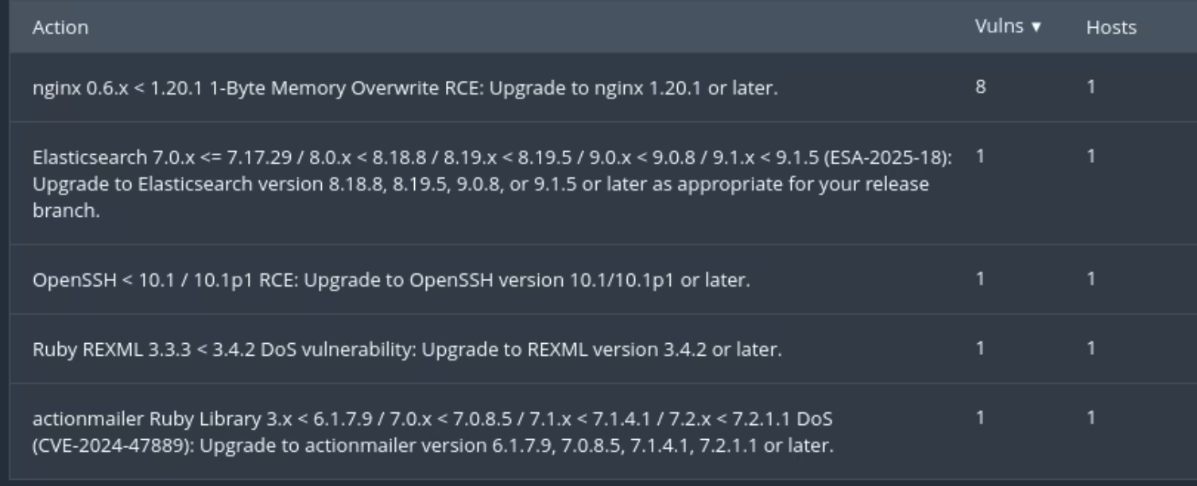

Threat Intelligence Brief
Kali Linux Security Assessment:
Test Environment
Analyst: AlJannat A. Uthman
Two high NGINX vulnerabilities were discovered in a Nessus scan. The first is a Byte Memory Overwrite RCE that leads to a crash (Denial of Service) with CVE-2021-23017 and CVSS score 7.7 High, affecting nginx 0.6.18 - 1.20.0. The second is an HTTP/2 implementation vulnerability leading to Denial of Service with CVE-2019-9511 and CVSS score 7.5 High.
Environment: Kali Linux (Intentionally Vulnerable)
Tool: Nessus
Vulnerabilities Discovered
Nginx Memory Overwrite RCE
Nginx HTTP/2 DOS
Vulnerability: nginx 0.6.x < 1.20.1 1 Byte Memory Overwrite RCE
Vulnerability: nginx 1.9.5 < 1.16.1 / 1.17.x < 1.17.3 HTTP/2 DOS
CVE ID: CVE-2021-23017
CVE ID: CVE-2019-9511
Risk Analysis and Mitigation
CVE
CVSS Score
Risk Summary
Solution
CVE-2021-23017
7.7 High
Security issue in Nginx resolver. An attacker able to forge UDP packets from the DNS server could cause a 1-byte memory overwrite, leading to a worker process crash or other impact.
Upgrade to Nginx 1.20.1 or later.
CVE-2019-9511
7.5 High
HTTP/2 implementations are vulnerable to window size and stream prioritization manipulation, potentially leading to Denial of Service (DOS) by forcing the server to queue data in 1-byte chunks, consuming excess CPU/memory.
Update Nginx to 1.16.1 or later, and update libnghttp2 to 1.40.0 or later.
Threat Actor Assessment
CVE-2021-23017 is not tied to any named adversary groups according to CISA and NISA.
CVE-2019-9511 has not been tied to widespread campaigns or ransomware.
ATT&CK Mapping
CVE ID
Tactic
Technique
Procedure
CVE-2021-23017
Initial Access (TA0001)
Exploit Public-Facing Application (T1190)
Attacker identifies internet-exposed NGINX with resolver directive
CVE-2021-23017
Impact (TA0040)
Network Denial of Service (T1498)
Forges UDP DNS responses, triggers 1-byte heap overwrite
CVE-2021-23017
Discovery (TA0007)
Remote System Discovery/Network Service Scanning
Scans for open UDP/53 and HTTP(S) ports
CVE-2021-23017
Defense Evasion (TA0005)
Impair Defenses
Spoofed DNS packets bypass source IP validation
CVE-2019-9511
Initial Access (TA0001)
Exploit Public-Facing Application (T1190)
Targets HTTP/2-enabled servers
CVE-2019-9511
Impact (TA0040)
Network Denial of Service (T1498)
Opens many HTTP/2 streams, sends large DATA frames in 1-byte chunks
CVE-2019-9511
Discovery (TA0007)
Network Service Scanning
Probes HTTP/2 support via ALPN
Indicators of Compromise (IOCs)
Since there are no public campaigns or adversaries attached to these vulnerabilities, there are no known IOCs. However, indicators can be derived from exploit behavior including network/traffic analysis, system/application logs, memory dumps, and unusual process behavior.
Business Risks
Service Downtime (DoS) - High likelihood, up to $1M recovery cost
Brand damage and customer trust loss - Medium likelihood, over $1M in revenue/recovery
Regulatory non-compliance - Medium likelihood, up to $1M in fines per incident
Data breach from RCE chain - Low to medium likelihood, up to $100M if successful
Cloud cost spikes
SOC Recommendations
Upgrade nginx to 1.20.1 and newer updates
Disable HTTP/2 if not required
Harden systems and improve SOC and Incident response playbooks
Challenges Faced
SSH Configuration Issues
Nessus Dashboard Lockout
Initial difficulty with SSH configuration, which was later determined to be non-critical for the assessment.
Forgot login credentials for the Nessus dashboard, requiring research to learn how to reset the password via the terminal, which was successful.

